Slide 1
HIGH-PERFORMANCE POLYMERS
Dr.Widad Saleh
Lecture Five
Polymers are lightweight and can be processed
easily and economically into a wide range of shapes and forms. The major synthetic efforts at
present are aimed at polymers with high temperature, liquid crystal, conducting, and nonlinear
optical properties
Requirements for High-Temperature Polymers
high-temperature polymer, refer to a high-performance polymer that can be
utilized at higher use temperatures; that is, its mechanical strength and modulus, stability
to various environments (chemical, solvent, UV, oxygen), and dimensional stability at higher
temperatures match those of other polymers at lower temperatures

Slide 2
HIGH-PERFORMANCE POLYMERS
The strengths of the primary bonds in a polymer are the single most important determinant of
the heat resistance of a polymer structure. This is especially critical with respect to the bonds
in the polymer chain. Breakage of those bonds results in a deterioration of mechanical
strength due to the drop in molecular weight
Breakage of those bonds results in a deterioration of mechanical
strength due to the drop in molecular weight
The inclusion of other functional groups in the polymer chain requires careful choice to
avoid introducing weak links into an otherwise strong chain. Certain functional groups (ether,
sulfone, imide, amide, CF2) are much more heat-resistant than others (alkylene, alicyclic,
unsaturated, NH, OH).
Ladder or semi ladder polymer structures
are possible for chains constructed of ring structures. A ladder polymer has a double-strand
structure with an uninterrupted sequence of rings in which adjacent rings have two or more
atoms in common

Slide 3
HIGH-PERFORMANCE POLYMERS
Ladder Structures
High molecular weight and crosslinking are desirable for the same
reason. Strong secondary attractive forces (including dipole–dipole and hydrogen bond interactions)
improve heat resistance. Crystallinity increases heat resistance by serving as physical
crosslinks that increase polymer chain rigidity and the effective secondary attractions.
Branching lowers heat resistance by preventing close packing of polymer chains.

Slide 4
HIGH-PERFORMANCE POLYMERS
The factors that lead to increased heat resistance also present problems with respect to the synthesis of polymers and their utilization:-
1- Rigid polymer chains lead to decreased polymer solubility.
2- Low-molecular-weight polymers may precipitate from the reaction mixture and prevent further polymerization.
3- Polymers with highly rigid chains may also be infusible and intractable.
The synthesis of heat-resistant polymers may then require a compromise away from polymer chains with
maximum rigidity in order to achieve better solubility and processing properties. There are
two general approaches to this compromise.
1-involves the introduction of some flexibilizing linkages, such as isopropylidene, CO, and SO2, into the rigid polymer chain by using an appropriate monomer or comonomer. Such linkages decrease polymer chain rigidity while increasing solubility and processability.
2- The other approach involves the synthesis of reactive telechelic oligomers containing functional end groups capable of reacting with each other.
.

Slide 5
HIGH-PERFORMANCE POLYMERS
1- Aromatic Polyethers by Oxidative Coupling
Tg 210 C
Tm 262 C
2-Aromatic Polyethers by Nucleophilic Substitution
Y is C=O,S=O
X is halogen

Slide 6
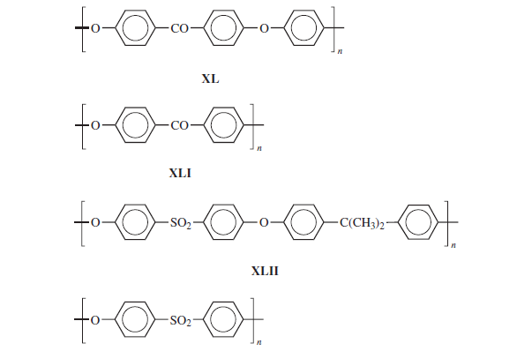
HIGH-PERFORMANCE POLYMERS
Q: Give the Tg values of these polymers

Slide 7
HIGH-PERFORMANCE POLYMERS
3- Aromatic Polysulfides
Tm 285 C
Crystallinity 60 %
4- Aromatic Polyimides

Slide 8
HIGH-PERFORMANCE POLYMERS
Polyimides (PIs) are mostly amorphous materials with high glass transition temperatures.
The resistance of PI to organic solvents is excellent. Polyimides show good oxidation resistance
and hydrolytic stability toward acidic environments, comparable to PET and better than
nylon 6/6. However,
Appropriate dianhydride and diamines are used to increase solubility and melt processability by decreasing
molecular order and packing. This is done by introducing flexible segments [aliphatic, O,
S, CO, SO2, C(CH3)2, C(CF3)2] into the polyimide chains or bulky side groups.
5- Polyether imides
Polyetherimides (PEI) are polyimides containing sufficient ether as well as other flexibilizing
structural units to impart melt processability by conventional techniques, such as injection
molding and extrusion.

Slide 9
HIGH-PERFORMANCE POLYMERS
PEI is amorphous with a glass transition temperature of 215C and continuous-use temperature
of 170–180C.(Trade Name : Altem )

Slide 10
HIGH-PERFORMANCE POLYMERS
6-Polyamidesimides
Polyamideimides (PAIs) (trade name: Torlon), containing both amide and imide functional
groups in the polymer chain, are produced by the reaction of trimellitic anhydride
(or a derivative) with various diamines.PAI resins are amorphous polymerswith glass transition temperatures of 270–285C and continuous-use temperatures of 220–
230C..
7- Bismalimides
(BMI) polymers are produced by reaction of a diamine and a bismaleimide.
Polymerization is carried out
with the bismaleimide in excess to produce maleimide end-capped telechelic oligomers
(XLVI). Heating at temperatures of 180C and higher results in crosslinking via radical chain
polymerization

Slide 11
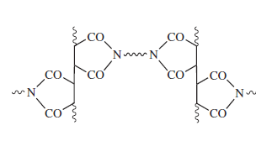
HIGH-PERFORMANCE POLYMERS

Slide 12
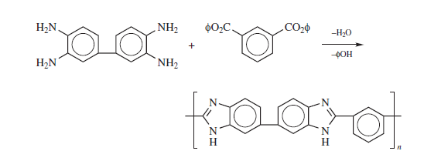
HIGH-PERFORMANCE POLYMERS
7- five member ring heterocyclic polymers
Has good mechanical properties and heat stability up to 300 C
Polyimides obtained from the reaction of diamine (tetraamines ) with dicarboxylate

Slide 13
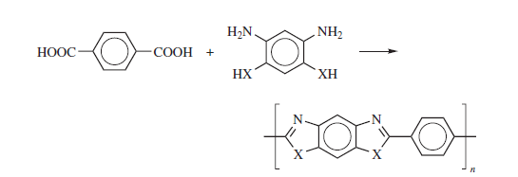
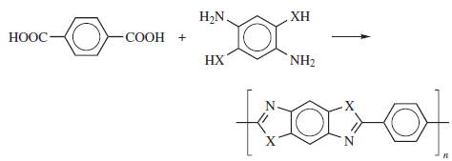
Polybenzoxazole (PBO)

Slide 14
8- poly (p-phenylene )
One of the earliest attempts to synthesize heat-resistant polymers was the oxidative polymerization
of benzene to poly(p-phenylene) [IUPAC: poly(1,4-phenylene)]
Aryl boronic acid
Suzuki coupling
Aryl bromide

Slide 15
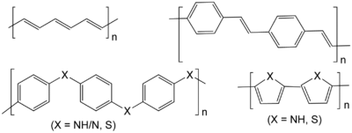

Slide 16
Thank you for your attention

